Slide 1
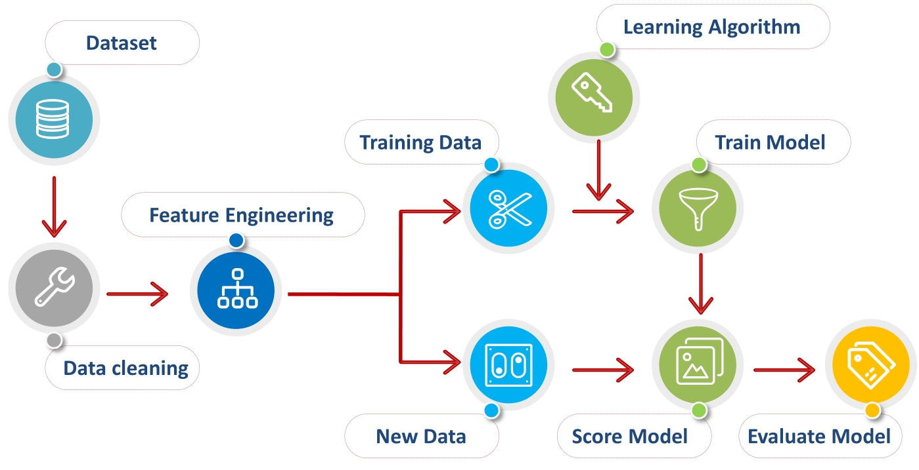






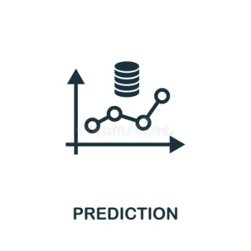
System Architecture
Data Reduction
USER
UI
MODEL
Data Transformation
INPUT
DATA PREPROCESSING

